Slide 1
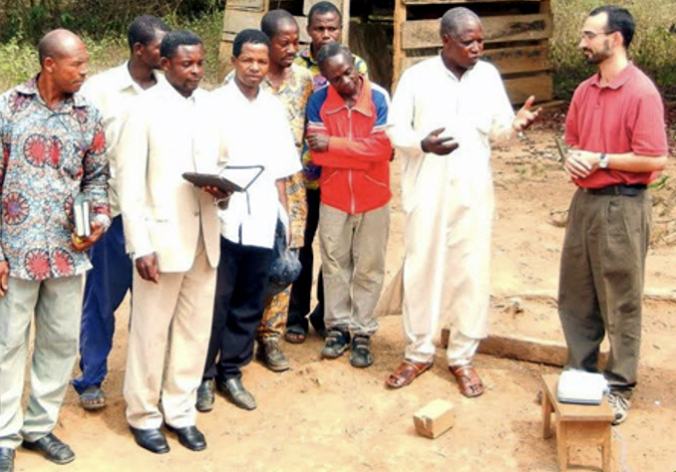
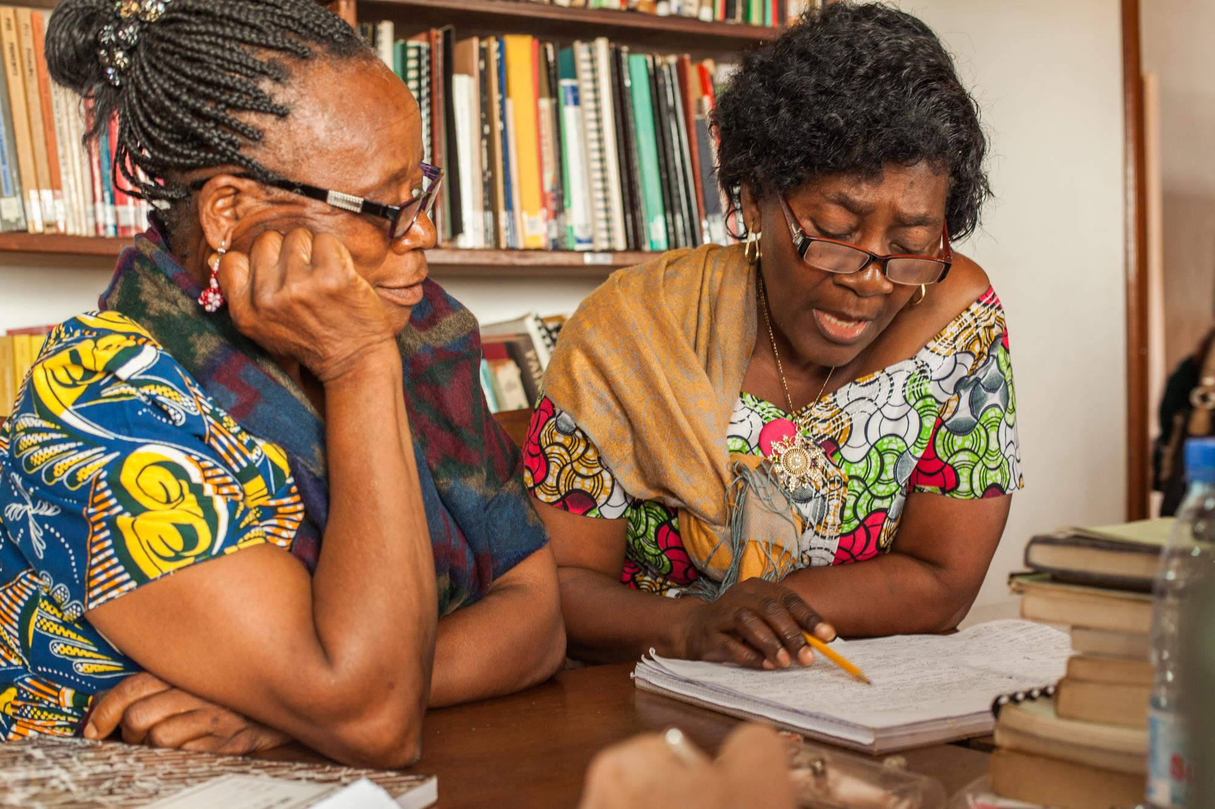
Using the Reviewers’ Guide (RG)
Collecting feedback from other believers.

Slide 2
Why seek community feedback?
To improve quality
To gain community support

Slide 3




People needed
Leader (1)
Translation team member
Biblical background
Good reputation
Good relationship with team
Access to Gateway Language Scripture
Strong bilingual skills
Reviewers (2 to 4 people)
Mother-tongue believers
NOT translation team members
Christians in good standing
Desire to see Scriptures in their Heart Language

Slide 4
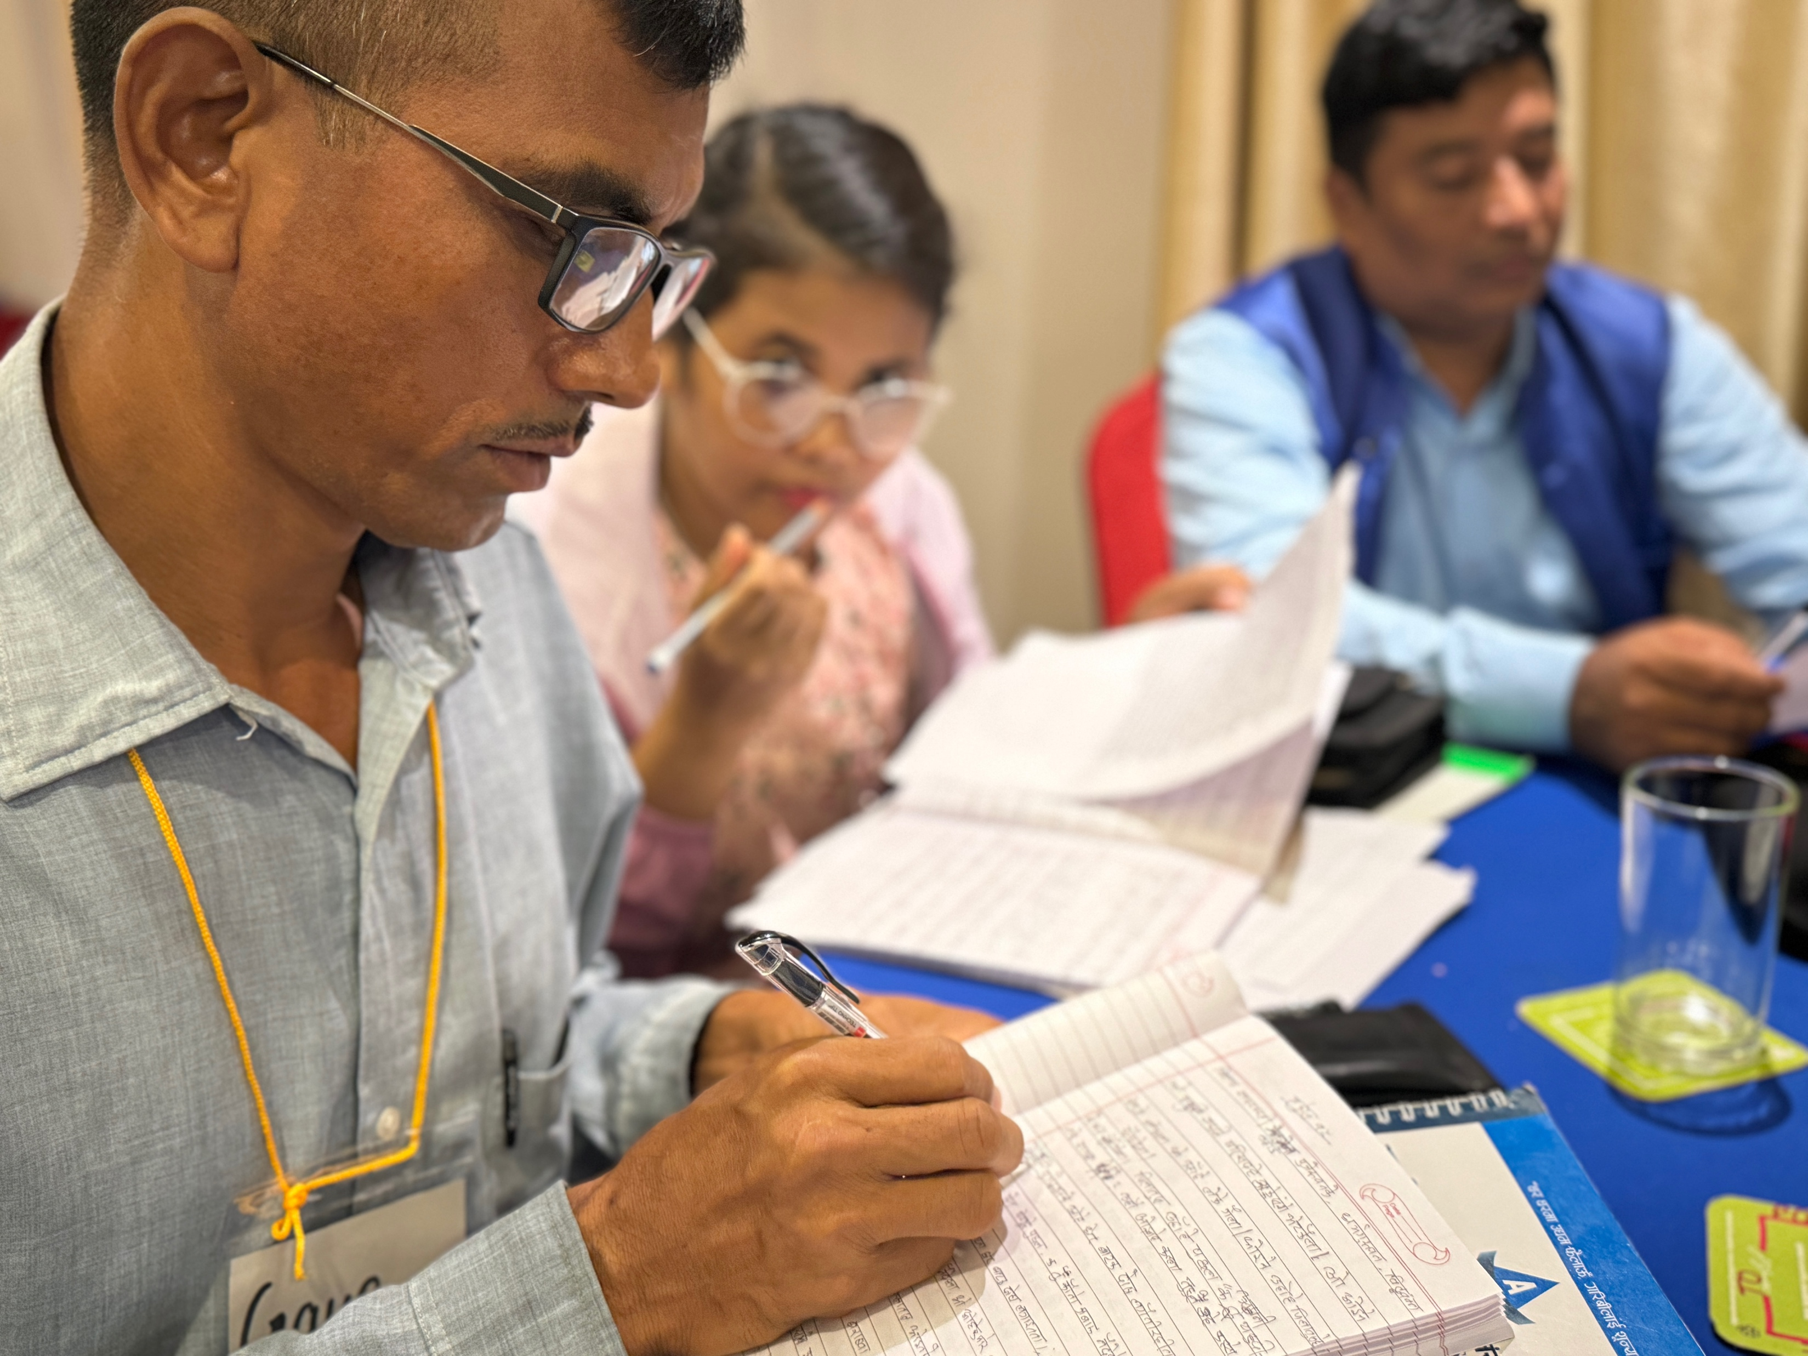
Prepare for Review
Find place to meet
Find 2-4 mother-tongue Christians to participate
Collect materials:
A printed copy of Reviewers’ Guide
Printed Scripture for leader and reviewers
Access to Gateway Language Scripture
Pen and paper

Slide 5
Review a Passage
Give background information
Read the translated passage
Part 1:
Ask for a summary
Check boxes for each complete answer
Part 2:
Ask questions
Make notes on any issues
Leader
Listen/read along
Part 1:
Share summary of passage
Part 2:
Look at verses
Answer questions
Reviewers

Slide 6
Matthew 3:13-17
Background: After Jesus grew up, John the Baptist went into the wilderness and preached that people should stop sinning and be baptized. John also taught that someone more powerful than he would come, and that person would judge people.
Read the passage.
Part 1
Tell in your own words what you just read in the passage.
Jesus came to the Jordan River to be baptized by John. [3:13]
John tried to stop Jesus, but Jesus said that it was right for John to baptize him. [3:14-15]
After John baptized Jesus, God’s Spirit came down like a dove and rested on Jesus. [3:16]
A voice from heaven said, “This is my beloved Son. I am very pleased with him.” [3:17]

Slide 7
Part 2
Answer the following questions from the specified verses:
[3:14] When Jesus came to be baptized, what did John tell Jesus?
John told Jesus that he needed to be baptized by Jesus.
[3:15] What did Jesus say was the reason that John should baptize him?
It was right for them to fulfill all righteousness.
[3:16] What did the Spirit of God do when Jesus came out of the water?
The Spirit of God came down and rested on Jesus.
[3:17] What did the voice from heaven say after Jesus came out of the water?
The voice said, “This is my beloved Son. I am very pleased with him.”
[3:17] Whose voice do you think was speaking?
By saying the voice came out of heaven, the passage shows that it was the voice of God the Father.

Slide 8
Review of Key Points
Review of translation, not of the reviewers
No editing here… Why ?
Each question has a verse reference.
Answers are based on translation read.
Limit of 5 minutes of discussion per question
Not every passage of New Testament reviewed
Listen to whole passage first.
Not every verse has a question.
“What do you think . . .” —asks for implied information.
Feedback for completeness and clarity

Slide 9
Try it

Slide 10


